Slide 1
Neuron Model and Network Architectures
Grace J. Hwang
Readings: Chapter 2; Hagan

Slide 2
Outline
Objectives
Theory and Examples
Notation => 符號
Neuron Model
Single-Input Neuron => 單一輸入神經元
Transfer Functions => 轉換函式
Multiple-Input Neuron => 多輸入神經元
Network Architectures
A Layer of Neurons
Multiple Layers of Neurons => 上一層的輸出就是下一層的輸入
Network Architecture Design

Slide 3
Objectives
Introduce the simplified mathematical model of the neuron
Explain how these artificial neurons can be interconnected to form a variety of network architectures
Illustrate the basic operation of these neural networks

Slide 4
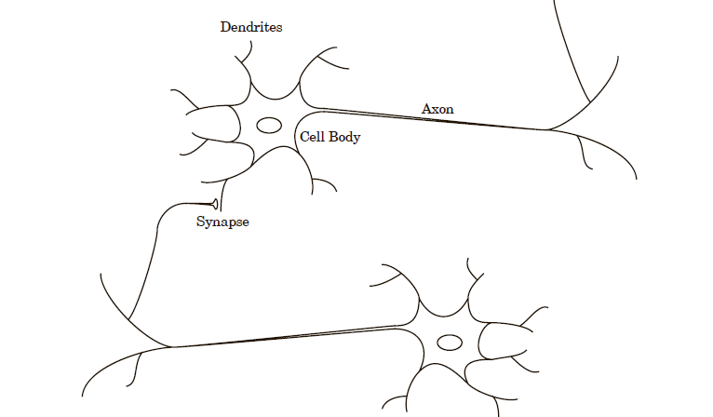
Biology
樹突
軸突
細胞體
突觸

Slide 5
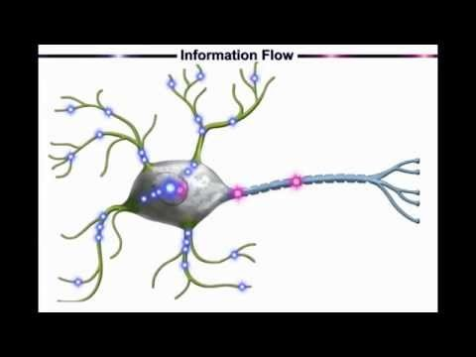
Biology
Neural Networks: A Simple Explanation
https://youtu.be/gcK_5x2KsLA

Slide 6
Biology
A neuron consists of a cell body (細胞體) , dendrites (樹突) and an axon (軸突).
Neurons are massively interconnected, where an interconnection is between the axon of one neuron and a dendrite of another neuron.
This connection is referred to as a synapse (突觸).

Slide 7
Notation
Scalars: small italic letters
e.g., a, b, c
Vectors: small bold nonitalic letters
e.g., a, b, c
Matrices: capital BOLD nonitalic letters
e.g., A, B, C
A complete list of the notation is given in Appendix B

Slide 8
Neuron Model
Single-Input Neuron
Transfer Functions
Hard limit transfer function
Linear transfer function
Log-sigmoid transfer function
Multiple-Input Neuron

Slide 9
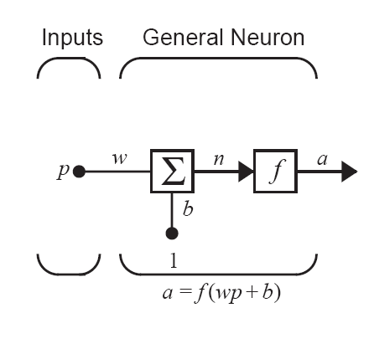
Single-Input Neuron (1/3)
Scalar input: p
Scalar weight: w
Bias: b
Net input: n
Transfer function : f
Output: a

Slide 10
Single-Input Neuron (2/3)
Example:
n = wp + b
a = f(n) = f(wp + b)
w=3, p=2 and b= −1.5,
then
a = f(3×2−1.5) = f(4.5)
synapse
p
w
axon
Σ
f(·)
a
1
b
dendrites
cell body

Slide 11
Single-Input Neuron (3/3)
Bias and Weight
The bias b is much like a weight w, except that it has a constant input of 1. It can be omitted for some situation.
Bias b and weight w are both adjustable scalar parameters of the neuron. They can be adjusted by some learning rule so that the neuron input/output relationship meets some special goal.

Slide 12
Transfer Functions
The transfer function f may be a linear or nonlinear function of n
Three of the most commonly used functions
Hard limit transfer function
Linear transfer function
Log-sigmoid transfer function

Slide 13
Hard Limit Transfer Function
N = 平面座標的X
A = 平面座標的Y
a=hardlim(n)
a=hardlim(wp+b)
a = 0, if n < 0
a = 1, if n ≥ 0
MATLAB function: hardlim

Slide 14
Linear Transfer Function
a=purelin(n)
a=purelin(wp+b)
a = n
MATLAB function: purelin

Slide 15
Log-Sigmoid Transfer Function
a=logsig(n)
a=logsig(wp+b)
a = 1/(1+exp(−n))
MATLAB function: logsig

Slide 16
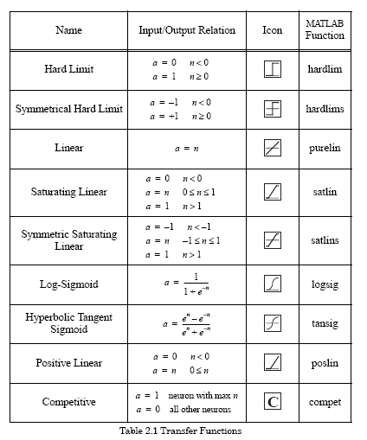
Other Transfer Functions

Slide 17
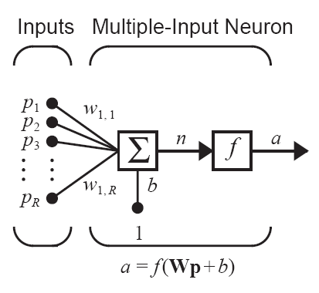
Multiple-Input Neuron (1/2)
Typically, a neuron has more than one input.
A neuron with R inputs is shown below.
The individual inputs p₁, p₂,…, p_{R} are each weighted by corresponding elements w₁₁, w₁₂,…,w_{1R} of the weight matrix W.
Net input: n = w₁₁ p₁ + w₁₂ p₂+…+ w_{1R}p_{R} + b = Wp + b
Neuron output: a = f(Wp + b)

Slide 18
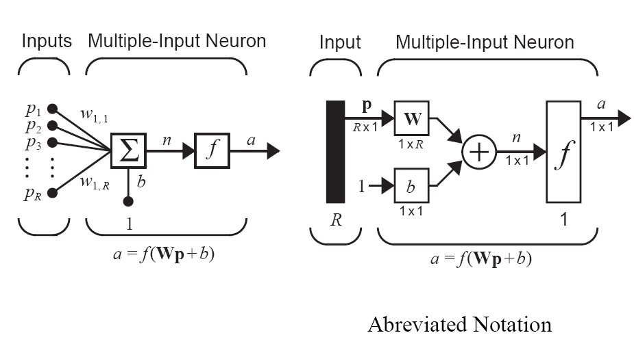
Multiple-Input Neuron (2/2)

Slide 19
Network Architectures
A Layer of Neurons
Multiple Layers of Neurons
Network Architecture Design

Slide 20
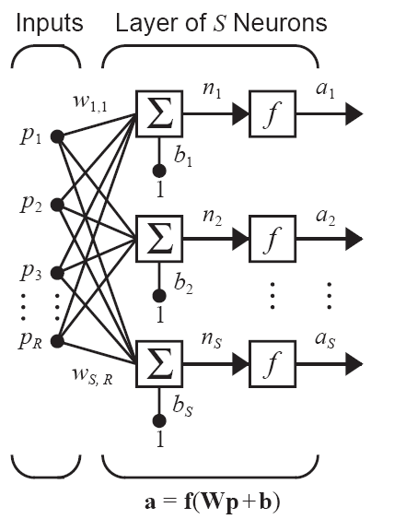
A Layer of Neurons (1/3)
A single-layer network of neurons is shown on the right.
Note that each of the R inputs is connected to each of the neurons and that the weight matrix W now has S rows.

Slide 21
A Layer of Neurons (2/3)
R: number of input
S: number of neuron in a layer (R ≠ S, usually)
Input vector p is a vector of length R
Bias vector b and output vector a are vectors of length S
Weight matrix W is an S×R matrix

Slide 22
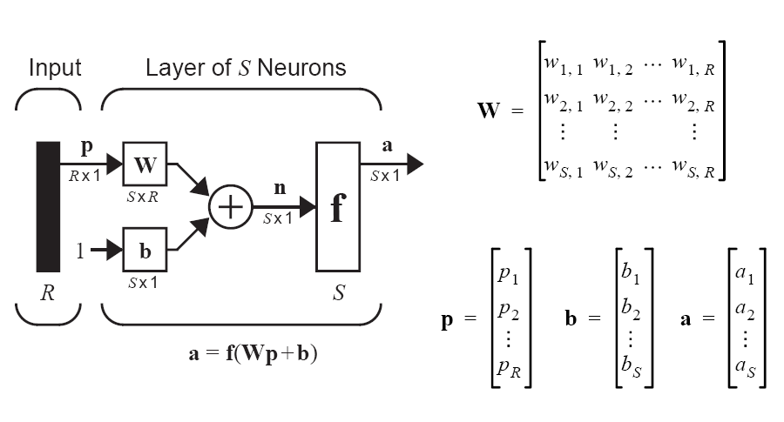
A Layer of Neurons (3/3)
Abbreviated Notation

Slide 23
Multiple Layers of Neurons (1/6)
Now consider a network with several layers.
Each layer has its own weight matrix W,
its own bias vector b,
a net input vector n and
an output vector a
We need to introduce some additional notation to distinguish between these layers. We will use superscripts to identify the layers.

Slide 24
Multiple Layers of Neurons (2/6)
Notation:
Layer Superscript: the number of the layer
e.g., the weight matrix for the first layer is W¹
R inputs, S ^{n} neurons (nodes) in the nth layer
Different layers can have different numbers of neurons.
Layer 1 has S ¹ neurons
Layer 2 has S ² neurons
…
The outputs of layer k are the inputs of layer (k+1)

Slide 25
Multiple Layers of Neurons (3/6)
Weight matrix W ^{j} between layer i and j is an S ^{j}×S ^{i} matrix, e.g. W ² is an S ²×S ¹ matrix
Recall that
The weight matrix W is S×R for a single-layer network of neurons, where R is the number of inputs and S is the number of neurons in the layer
Now, the input to layer 2 is a¹, and the output is a².
a¹ is a vector of length S¹ ⇒ layer 2 has S¹ inputs
a² is a vector of length S² ⇒ layer 2 has S² outputs
Therefore the weight matrix W ² is an S ²×S ¹ matrix

Slide 26
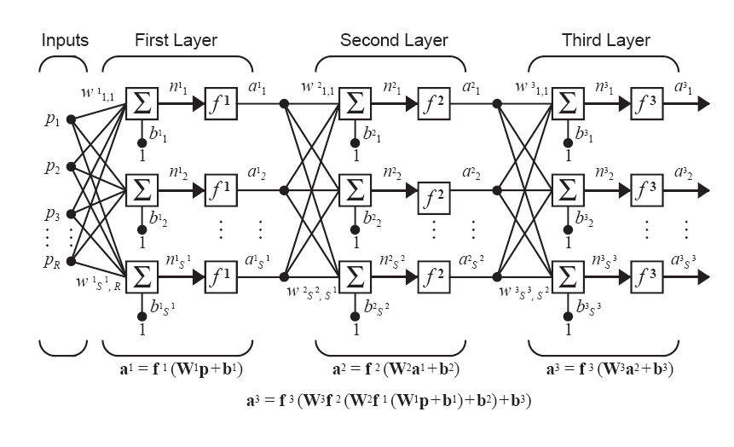
Multiple Layers of Neurons (4/6)
Multiple-Layer Network

Slide 27
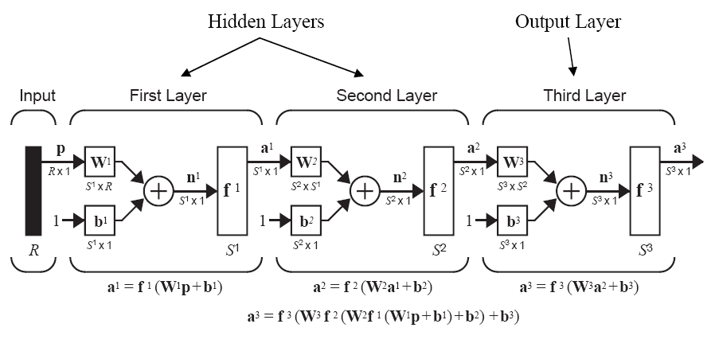
Multiple Layers of Neurons (5/6)
Abbreviated Notation

Slide 28
Multiple Layers of Neurons (6/6)
The layer that receives inputs is called the input layer.
The outputs of the network are generated from the output layer.
Any layer between the input and the output layers is called a hidden layer.

Slide 29
Network Architecture Design (1/3)
Multilayer networks are more powerful than single-layer networks.
For instance, a two-layer network having a sigmoid first layer and a linear second layer can be trained to approximate most functions arbitrarily well.
Single-layer networks cannot do this.
The number of inputs to the network and the number of outputs from the network are defined by external problem specifications.

Slide 30
Network Architecture Design (2/3)
Number of inputs and outputs
If there are four external variables to be used as inputs, there are four inputs to the network.
If there are to be seven outputs from the network, seven neurons in the output layer can be designed.
Transfer function for the output layer
If an output is to be either -1 or 1, then a symmetrical hard limit transfer function should be used.

Slide 31
Network Architecture Design (3/3)
The number of layers
It depends on the problem you try do model. The more layers you have, the harder it is to train the network (more computation power needed).
The deeper the layer is however, the more complex problems it can solve.
With or without biases
The bias gives the network an extra variable, and networks with biases would be more powerful than those without.

